Slide 1

Pre-Processing EDA

Slide 2
Data Preparation and data preprocessing
Duplicate values
Missing values
Outliers
Feature engineering
Data encoding
Train test split
Train (train , validation) , why validations
Test
Data leakage
EDA
Model preparation
evaluation
Ml
Overfitting
Underfitting
Genralized model
Bias- variance trade-off
Variance
Bias

Slide 3
EDA and Preprocessing - AUTOMOBILE CARS
Basic EDA - Info, shape
Handling Missing Values
Handling Outliers
Handling Skewness
Categorical Data Encoding
Data Normalization or Scaling
Feature Engineering
https://scikit-learn.org/1.5/api/sklearn.datasets.html
https://github.com/mwaskom/seaborn-data
https://www.kaggle.com/datasets/burak3ergun/loan-data-set?resource=download

Slide 4
Basic EDA - Info, shape
df.info()
df.describe()
https://www.analyticsvidhya.com/blog/2022/07/step-by-step-exploratory-data-analysis-eda-using-python/

Slide 5
Handling Missing Values
df.isna().sum() # show the null values
df.dtypes
# replace the null with mean or median or anyvalue
df["Fuel_capacity"].fillna(df["Fuel_capacity"].mean())
# df['embark_town'] = df['embark_town'].fillna("Southampton")
df.dropna(inplace=True)
df.isna().sum()
df.duplicated().sum() # check duplicate
# drop duplicate
df.drop_duplicates(inplace=True)
https://www.analyticsvidhya.com/blog/2021/10/handling-missing-value/
https://www.geeksforgeeks.org/ml-handling-missing-values/

Slide 6
Handling Outliers
Q1 = df['Price_in_thousands'].quantile(0.25)
Q3 = df['Price_in_thousands'].quantile(0.75)
IQR = Q3-Q1
IQR
lower_fence = Q1-1.5*IQR
upper_fence = Q3+1.5*IQR
#dropping the outlier
df_filtered = df[(df.Price_in_thousands >= lower_fence) &
(df.Price_in_thousands <= upper_fence)]
import matplotlib.pyplot as plt
import seaborn as sns
df.columns
#To check outliers >> distplot, boxplot
plt.figure(figsize = (12, 5))
plt.subplot(1, 2, 1)
sns.histplot(df['Price_in_thousands'], kde = True)
plt.title("Dist plot")
plt.subplot(1, 2, 2)
sns.boxplot(data = df, x = 'Price_in_thousands')
plt.title("Box plot")
plt.show()
https://medium.com/analytics-vidhya/how-to-remove-outliers-for-machine-learning-24620c4657e8
https://www.analyticsvidhya.com/blog/2021/05/detecting-and-treating-outliers-treating-the-odd-one-out/

Slide 7
Handling Skewness
### Understanding the distribution of the column - __year_resale_value
sns.distplot(df['__year_resale_value'], label = 'Skewness: %.2f'%(df['__year_resale_value'].skew()))
plt.legend(loc = 'best')
plt.title('Distribution of the column - __year_resale_value')
import statsmodels.api as sm
from scipy import stats
https://machinelearningmastery.com/skewness-be-gone-transformative-tricks-for-data-scientists/
### Understanding the distribution of the data Box_Cox(__year_resale_value)
year_data = [1 if value == 0 else value for value in modified_dataset['__year_resale_value']]
modified_year, _ = stats.boxcox(year_data)
modified_dataset['__year_resale_value'] = modified_year
sns.distplot(modified_dataset['__year_resale_value'], label = 'Skewness: %.2f'%(modified_dataset['__year_resale_value'].skew()))
plt.legend(loc = 'best')
plt.title('Distribution of the column - __year_resale_value')

Slide 8
Categorical Data Encoding
LabelEncoding
df = pd.DataFrame({'status': ['Single', 'Married', 'Single', 'Relationship', 'Married', 'Single']})
from sklearn.preprocessing import LabelEncoder
label_encoder = LabelEncoder()
label_encoder.fit_transform(df[['status']])
OrdinalEncoder
from sklearn.preprocessing import OrdinalEncoder
df = pd.DataFrame({"qualification": ["HS", "PG","GR", "HS", "PhD", "HS", "PG"]})
encoder = OrdinalEncoder(categories = [["HS", "GR", "PG", "PhD"]])
encoder.fit_transform(df[['qualification']])
#using pandas
pd.get_dummies(df['status'], drop_first=True, dtype = 'int')

Slide 9
OneHotEncoder
from sklearn.preprocessing import OneHotEncoder
encoder = OneHotEncoder()
encoder
encoded = encoder.fit_transform(df[['status']]).toarray()
encoder.get_feature_names_out()
df = pd.DataFrame({'status': ['Single', 'Married', 'Single', 'Relationship', 'Married', 'Single']})
encoder = OneHotEncoder()
encoder
encoded = encoder.fit_transform(df[['status']]).toarray()
encoder.get_feature_names_out()
encoder_df = pd.DataFrame(encoded, columns = encoder.get_feature_names_out())
final_df = pd.concat([df, encoder_df], axis = 1)
final_df.drop(['status','status_Married'], axis = 1, inplace=True)
### One Hot Encoding the columns - Manufacturer, Vehicle_type of the modified dataset
encoded_dataset = pd.get_dummies(data = modified_dataset, columns = ['Manufacturer', 'Vehicle_type'])
encoded_dataset
#using pandas
pd.get_dummies(df['status'], drop_first=True, dtype = 'int')
https://medium.com/anolytics/all-you-need-to-know-about-encoding-techniques-b3a0af68338b
https://www.analyticsvidhya.com/blog/2020/08/types-of-categorical-data-encoding/

Slide 10
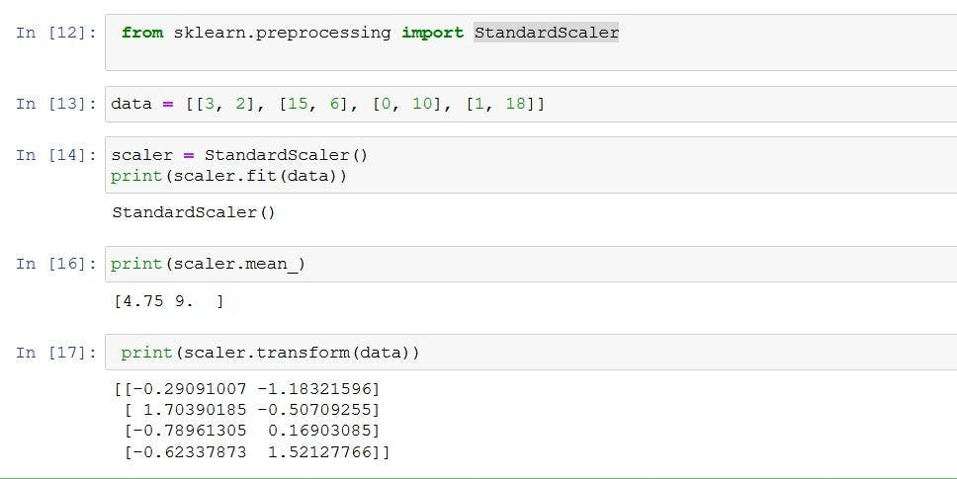
Data Normalization or Scaling
from sklearn import preprocessing
import numpy as np
x_array = np.array([2,3,5,6,7,4,8,7,6])
normalized_arr = preprocessing.normalize([x_array])
print(normalized_arr)
### A function to normalize numerical columns
def normalize_columns(dataframe, column):
data = dataframe[column]
mini = min(data)
maxi = max(data)
new_data = []
for value in data:
new_data.append((value - mini)/(maxi - mini))
dataframe[column] = new_data
numerical_columns = ['Sales_in_thousands', '__year_resale_value', 'Engine_size', 'Horsepower', 'Wheelbase', 'Width',
'Length', 'Curb_weight', 'Fuel_capacity', 'Fuel_efficiency', 'Power_perf_factor', 'Age']
for each_column in numerical_columns:
normalize_columns(modified_dataset, each_column)
scaler = preprocessing.MinMaxScaler()
d = scaler.fit_transform(california_housing.data)
The normalize() function scales vectors individually to a unit norm so that the vector has a length of one.
The default norm for normalize() is L2, also known as the Euclidean norm.
The L2 norm formula is the square root of the sum of the squares of each value.
Although using the normalize() function results in values between 0 and 1,
it’s not the same as simply scaling the values to fall between 0 and 1.
https://www.geeksforgeeks.org/ml-feature-scaling-part-2/
https://www.analyticsvidhya.com/blog/2020/04/feature-scaling-machine-learning-normalization-standardization/

Slide 11
Feature Engineering
Feature selection is the process of reducing the number of input variables when developing a predictive model. It is desirable to reduce the number of input variables to both reduce the computational cost of modeling and, in some cases, to improve the performance of the model.
# 4.6.1 Plotting the correlation matrix for the numerical columns
https://www.geeksforgeeks.org/ml-feature-scaling-part-2/
### Creating a filter_dataset
filter_dataset = encoded_dataset[['Sales_in_thousands', '__year_resale_value', 'Engine_size', 'Horsepower', 'Wheelbase',
'Width', 'Length', 'Curb_weight', 'Fuel_capacity', 'Fuel_efficiency', 'Power_perf_factor',
'Age']]
filter_dataset
https://www.analyticsvidhya.com/blog/2021/10/a-beginners-guide-to-feature-engineering-everything-you-need-to-know/
https://www.geeksforgeeks.org/what-is-feature-engineering/
### Plotting the correlation between various columns of the filter_dataset
plt.figure(figsize = (10, 10))
heatmap = sns.heatmap(filter_dataset.corr(), vmin = -1, vmax = 1, annot = True)
heatmap.set_title('Correlation Heatmap', fontdict = {'fontsize' : 12}, pad = 12)
# 4.6.2 Removing the columns that cause multicollinearity using VIF (optional)

Slide 12
Multi- coliniarity (Optional)
Where a feature exhibits a linear relationship withmore then one variable.
It never talk about x→y
It is x1 explain by x2 and x3
What → one feature explain by other feature.
Why → you can not intercept correctly what is the contributions of each indivisual feature w.r.t Y
It is no necessary → no affect on prediction
But it reduce complexity and computition time
Solution find Mulit coliniarirt by (VIF) variance Inflaction factor
Vif = 1/ 1-Ri-square → % variation in y explained by X
Vif 0 to infinite
2nd option RFE(Recursive Feature Elimanations ) when

Slide 13
### Detecting the columns that cause multicollinearity using VIF
column_names = list(filter_dataset.columns)
for name in column_names:
if len(column_names) >= 2:
Y = filter_dataset.loc[:, filter_dataset.columns == name]
X = filter_dataset.loc[:, filter_dataset.columns != name]
X = sm.add_constant(X)
linear_model = sm.OLS(Y, X)
results = linear_model.fit()
r_squared = results.rsquared
vif_value = round(1/(1 - r_squared), 2)
print("Column: {} and VIF: {}".format(name, vif_value))
if vif_value > 10:
filter_dataset = filter_dataset.drop([name], axis = 1)
column_names.remove(name)
#clustermap table shows group(cluster ) relationship
plt.figure(figsize = (5, 5))
sns.clustermap(df.corr(), vmin = -1, vmax =1, annot = True)
from statsmodels.stats.outliers_influence import variance_inflation_factor
vif = pd.DataFrame()
vif['Feature'] = df.columns
vif
vif["VIF"] = [variance_inflation_factor(df.values, i) for i in range(len(df.columns))]
Others methods
from sklearn.feature_selection import RFE
rfe = RFE(estimator = LinearRegression(), n_features_to_select=6)
rfe.fit(X, y)
rfe.support_
rfe.ranking_

